Slide 1

Meeting of the FP2020 Indonesia Country Engagement Working Group
Deputy of FP and Reproductive Health
National Population and Family Planning Board
Jakarta, 23 May 2013

Slide 2




Track progress and report on financial and policy commitments made at the Summit, linking with established accountability processes for the UN Secretary General's Every Woman Every Child strategy;
Monitor and report on global and country progress toward the FP2020 Summit goals;
Identify obstacles and barriers to achieving Summit goals and recommend solutions;
Ensure promotion of voluntary family planning and concrete measures to prevent coercion and discrimination, and ensure respect for human rights;
Ensure data availability to support all of the above, consistent with country processes and sharing data, such as through a global score card; and
Publish an annual report to update the global community on progress and challenges.

Slide 3
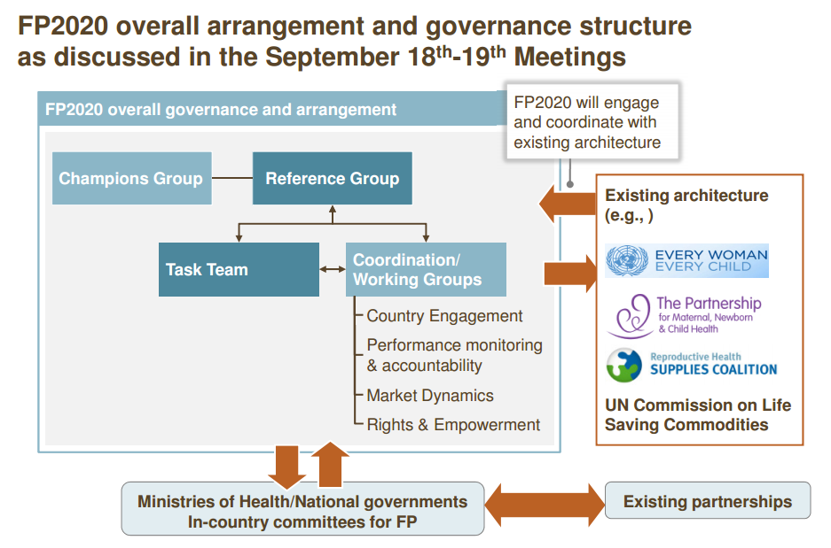
FP2020: MENJANGKAU 120 JUTA WANITA DENGAN INFORMASI, LAYANAN DAN SUPLAI
KELUARGA BERENCANA
Sumber: UN Population Division, DHS, Future Institute, Guttmacher Institute & team analysis

Slide 4
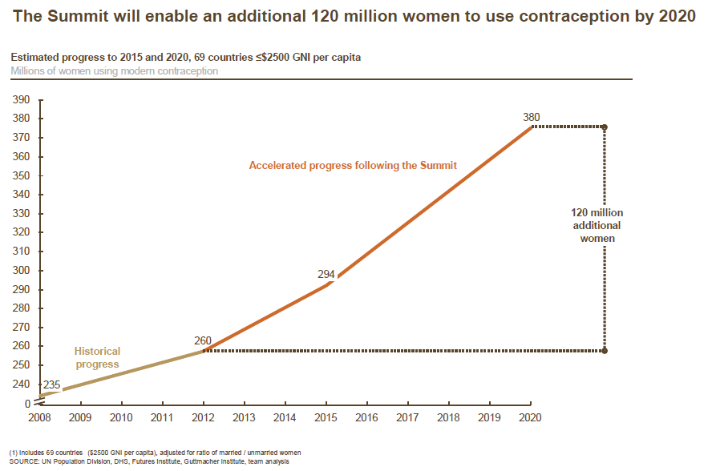
Goal of the summit
APPROACH:
Protection of the human rights of women and girls
Integration of FP within the continuum of care
Universal access to voluntary contraceptive information, services and supplies
Equity in policies and program design and implementation
Empowering women
Participatory development of country plans
Strong partnerships among and between a broad base of stakeholders
Commitment to results, transparency and accountability

Slide 5
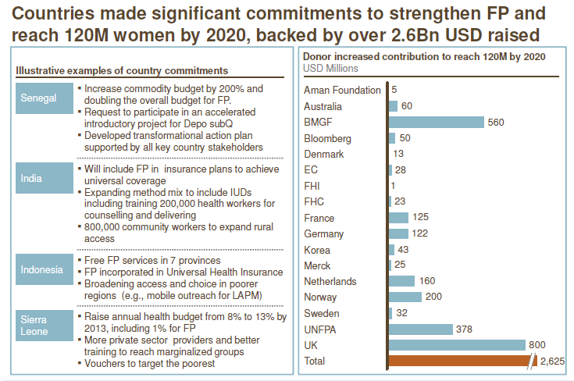

Slide 6
Barriers to contraceptive access:
Insufficient political commitment
Insufficient, inconsistent and unpredictable funding
Social, cultural, policy, and financial barriers to effective demand
Lack of quality services
Insufficient integration of family planning as a basic component of an essential package of primary health services.
Weak procurement and supply chains that result in contraceptive stock-outs.
High prices of mid- to long-acting, reversible contraceptive methods.
Insufficient investment in research and development of contraceptive methods

Slide 7
Funds raised for the London Summit on Family Planning will support in the following areas:
Increase the demand and support for family planning
Improve supply chains, systems and service delivery models
Procure the additional commodities countries need to reach their goals
Innovative approaches to any of the above through “family planning challenges”
Market dynamics
Promoting accountability through improved monitoring and evaluation
Advocacy
.
Proposals for Summit funding will be reviewed by family planning committees in existence or established at the country-level, with representation from country, civil society, and donor stakeholders. Where they exist already, countries can utilise the family planning components of their national health plans for consideration. Details regarding proposal review and funding approval are currently under discussion and will continue to be developed in the lead-up to the Summit and beyond

Slide 8
Proposal of Government of Indonesia to the Bill and Melinda Gates Foundation: “Reducing Unmet Need for Family Planning Through Revitalization of the National FP Programme”
Situational analysis:
Challenges associated with decentralization
Inadequate effective Information, Education and Communication provision regarding small family norms
Weakened capacity of frontliners in community mobilization
Inappropriate family planning method mix
Low provision of long acting and permanent methods in service delivery points
Relatively high drop out rate
Weak contraceptive management at the district level
Inadequate monitoring & evaluation system

Slide 9
Rationale for Bill and Melinda Gates Foundation investment
Alignment with Bill and Melinda Gates priority
.... contribute to ensure all couples regardless of their economic status or where they live have access to quality family planning information, services, and supplies
Following up post London Summit on Family Planning
Indonesia is one out of 18 member reference group
Enables Indonesia to translate overall strategic direction for FP2020 Drive coordination among stakeholders and
Be accountable for reaching 120 million additional women by 2020

Slide 10
Program Description
Goal (2014):
Increased number of new acceptor in Indonesia to be at 7.6 million
Increased number of poor new acceptor in Indonesia to be at 4.05 million
Increased number of active acceptor in Indonesia to be at 29.8 million
Increased number of poor active acceptor in Indonesia to be at 13.1 million
Increased the percentage of long acting and permanent method to be at 27.5% with special emphasis to the use of implant
Outcomes:
Increased adequate counseling on family planning directed to the use of LAPMs
Increased voluntarily LAPMs yielding fewer women having more than three children and birth intervals of fewer than 24 months
Reduced drop out rate
Increased coverage and quality of family planning services in urban slum and geographically remote areas

Slide 11
Program strategy
Target the sub national level
Strengthen the integration of family planning services in the continuum of care
Tailor support to local needs
Engage with NGOs and private sector
Close partnership with related profesional organizations
Emphasis sustainability
Ensure social inclusion

Slide 12
Areas of activity proposed and current programs’ position (1)
Main areas of activity | No | Activities | Indonesia’s current position*
Demand creation | 1. | Mitigating people’s perspectives on small family norms:
 |  | a. Family Planning and Reproductive Health mass campaign, | 3
 |  | b. Population issues awareness, | 2
 |  | c. Coordination forums, | 2
 |  | d. Scientific reviews / discussions, | 2
 |  | e. Other major activities aiming at enhancing people’s mindset. | 3
 | 2. | Advocacy to decison makers:
 |  | a. Strengthening FP issues through mutual collaboration with women’s parliamentarians and Indonesia Forum of Parliamentarians on Population and Development (IFPPD). | 3
 |  | b. Advocacy on Budgetting in FP and RH , guarded by NGOs affiliated with the Government. | 2
 |  | c. Capacity enhancement among decision or policy makers on FP and RH issues. | 3
* Likert scale: 1= Poor intervention 2= Fair intervention 3= Good intervention 4= Good intervention 5=Excellent intervention

Slide 13
Areas of activity proposed and current programs’ position (2)
Main areas of activity | No | Activities | Indonesia’s current position
Demand creation | 3. | Capacity building related to IEC/Counseling techniques and approaches:
 |  | Training for health providers and village community institutions (or IMPs) in FP counseling | 3
 |  | b. Strengthening capacity of health providers and vllage community institutions (or IMPs) in managing informed choice and infomed concent in FP services. | 3
 | 4. | Production of IEC/advocacy/promotion materials:
 |  | Development and production of IEC/advocacy/promotion materials into several communication media (printed and electronic). | 2
 |  | b. Development and dissemination of IEC/advocacy/promotion on FP and RH into several communication channels (modern and traditional). | 4
 |  | c. Development communication strategies redirected into interactive modus, which proven to be more prefered and understood by target audience. | 4
 |  | d. Changing strategies on IEC/BCC from above the line into below the line, emphasizing more inter personal / two-way-traffic communication. | 3

Slide 14
Areas of activity proposed and current programs’ position (3)
Main areas of activity | No | Activities | Indonesia’s current position
Demand creation | 5. | Policy support favoring to IEC/BCC:
 |  | Facilitating development of rules or legal products at all administrative levels and related parties | 3
 |  | b. Analysis document either to invent policies which are in line or less favor to FP and RH issues, or to measure to what extent a certain policy found to be effective in managing ideal population growth | 1

Slide 15
Areas of activity proposed and current programs’ position (4)
Main areas of activity | No | Activities | Indonesia’s current position*
Supply side interventions | 1. | Ensuring access to and quality of FP services
 |  | Mapping existing access to and quality of family planning services by using a standard and a structured instrument in association with the implementation of National Social Security Scheme for health | 3
 |  | b. Increasing coverage of FP service to provide LAMPs particularly at village level (Puskesmas, Poskesdes and Polindes) by the provision of equipments and supplies in addition to improving the infrastructure | 3
 |  | c. Strengthening a functioning referral networks to family planning services particularly in urban slum & poor physical infrastructure areas or due to geographical barrier | 2
 |  | d. Supporting implementation of standards of care including referral for any complications | 3
 |  | e. Designing and developing a mass e-learning and e-training system for health provider in collaboration with Indonesia's National Clinical Training Network | 1
 |  | f. Supporting incentive for greater private provision of LAPMs | 2

Slide 16
Areas of activity proposed and current programs’ position (5)
Main areas of activity | No | Activities | Indonesia’s current position*
Supply side interventions | 2. | Enhancing family planning program management
 |  | Supporting improvements in contraceptive supply chain management | 3
 |  | b. Supporting local government to attract and retain experienced health workers in rural, remote and poor areas | 1
 |  | c. Supporting the development of information and technology sub system in relation to contraceptive logistics and family planning service report | 2
 |  | d. Strengthening rapid survey data collection for program monitoring | 1
 |  | Providing performance based funding through government system for Puskesmas | 1

Slide 17
Strategies for Bill and Melinda Gates Foundation assistance
Technical assistance
Provide assistance for strategic planning
Support advocacy and consensus building
Assist with the development of sub-national management information system preferably IT constructed
Strengthen physical infrastructure of local organization and service site
Devise mechanism for improved commodity logistics
Support monitoring and evaluation activities
Training
Strengthen technical, management and planning capabilities
Support medical training for health provider
Develop skill for data collection, analysis and use
Policy analysis and research
Conduct need assessment
Analyze and rationalize roles and responsibilities of each level
Conduct legal and regulatory assessment
Support research
Information dissemination
Fund operational travel and workshops
Develop case studies and manuals
Assist with the development of locally relevant IEC materials

Slide 18
Timeframe, budgeting and modalities
Timeframe
The project is expected to start in 2013 and ended by 2020 to accomplish FP 2020 targets.
Budgeting
The project’s budgeting has been currently detailed for year 2013 and 2014, while further budgeting plan will be calculated until 2017 following the Mid-Term Budgeting Performances (or KPJM) procedure, and soon be able to allocate funds until 2020.
In year 2013, required fund is IDR 2,012 billions
GOI allocation at IDR 1,162 billions→GAP is IDR 849,36 billions.
In year 2014, required fund is IDR 3,412 billions
GOI allocation at IDR 1,595 billions→GAP is IDR 1,810 billions.
Budget plans for 2015 until 2017 will be soon calculated according to Medium-Term Expenditure Framework procedures.
Budget plans from 2018 to 2020 will follow afterward.

Slide 19
Modalities
All supports and fundings must be recognized in National Budget (or APBN)
According to an established fund channeling
Initially installed at several piloted provinces which in turns possibly be scalled up
Involving stakeholders at both central and local levels.

Slide 20
THANK YOU

